Slide 1
CIS 399 Project
Embodiment of the Shopping Application
Jenny Lee

Slide 2
Shopping Application Overview
Main Layout: the first thing you see for the application.
List Layout: listing of products and the price.
Cart Layout: when the product is clicked, it increments the price of the what you have clicked, and show overview and the total price number to check out.
Menu: menu to navigate settings and about the application to see the information of the application.

Slide 3
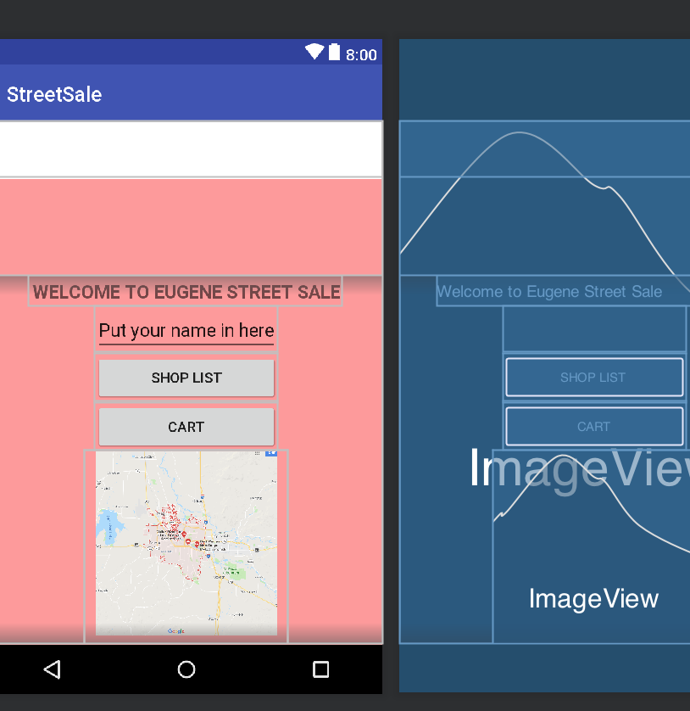
Main Layout Overview
Frame Layout
background Image
toolbar
Linear Layout
Text view
Edit Text
Button – when clicked, to listings
Button – when clicked, to the cart
Image View

Slide 4
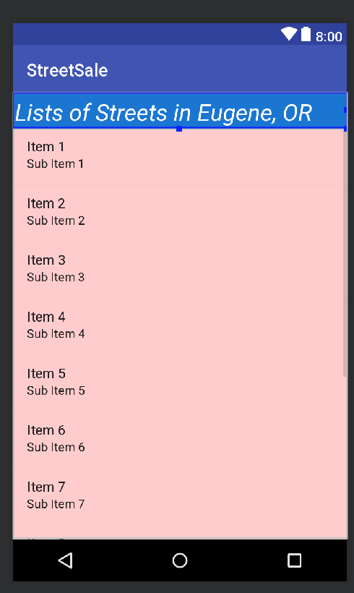
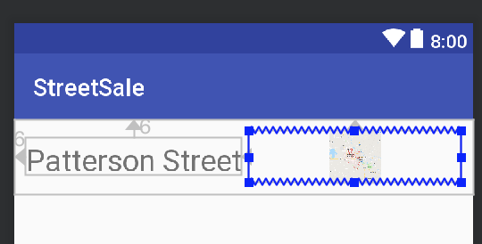
List View Overview
Relative Layout
Text View
Image View
Table Layout – when clicked, it saves the clicked one and increment the price so that it could be found in the cart
Title Text
Item List

Slide 5
Cart Overview
Saves its clicked lists and then increment the price, and show it on the cart with your name, the total price of the clicked lists.

Slide 6
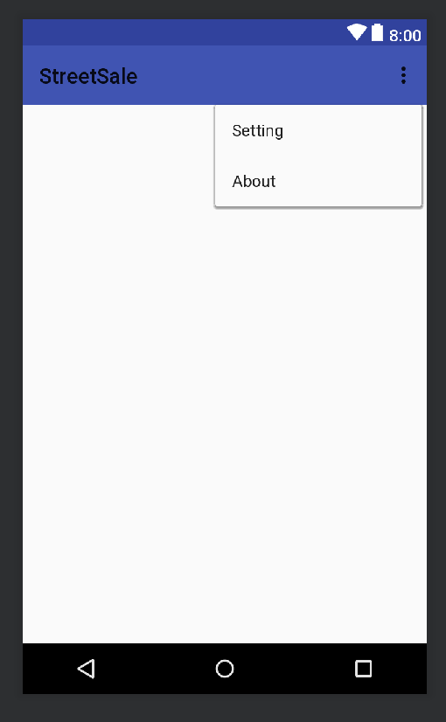
Menu Overview
Shows in the main layout
Setting – when clicked, goes to the preference to change background of the application.
About – Toast of the copyright of the application and the descriptions of the application.

Slide 7
Thank you!

